Slide 1
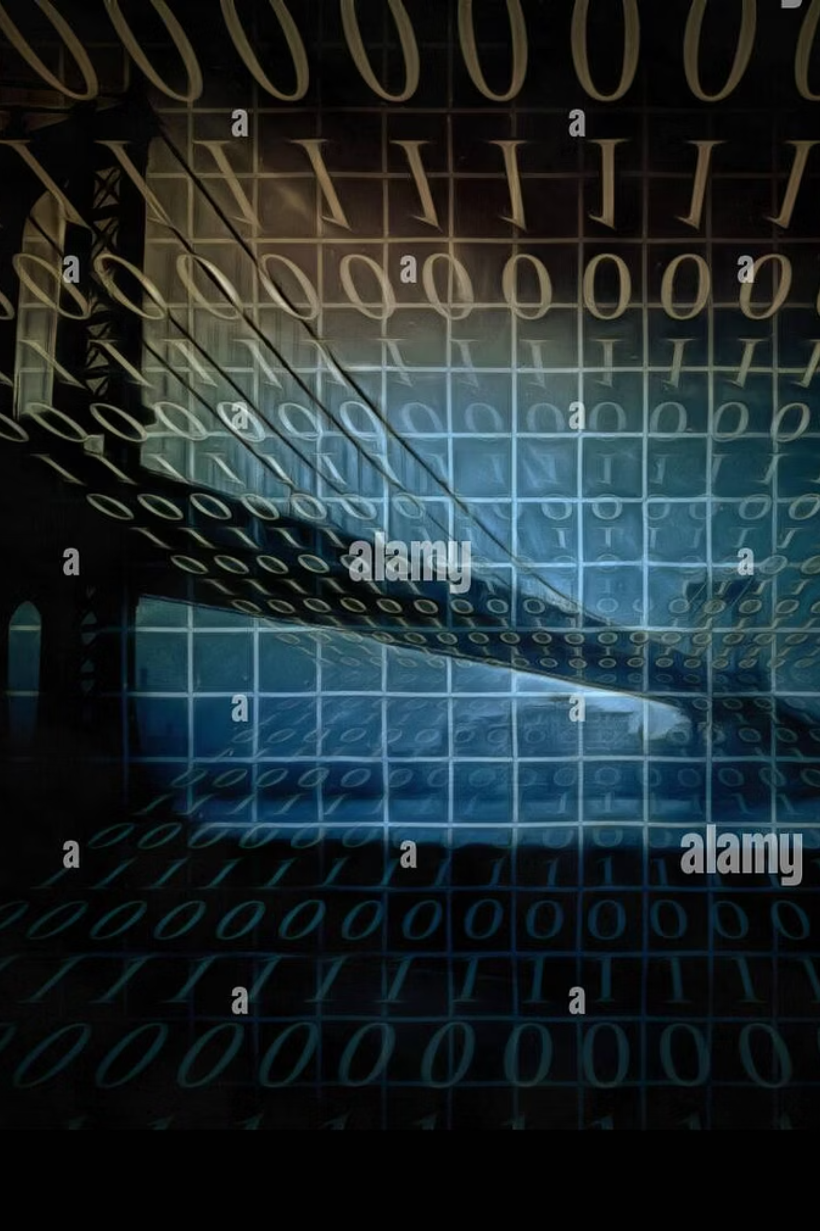
Huffman Encoding Tokenizer
An efficient approach to data compression and binary tree construction.

Slide 2
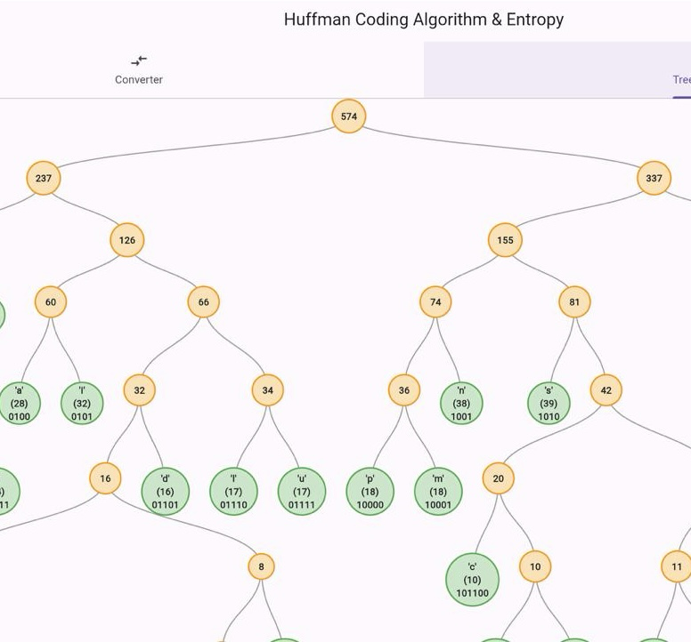
Introduction: The Challenge of Data Compression
Lossless Compression
Why Huffman?
Our focus is on lossless data compression, where original data can be perfectly reconstructed from the compressed form.
Huffman coding employs variable-length prefix codes based on character frequencies, optimising storage efficiency.
Project Goal
Beyond merely calculating codes, our project provides an interactive visualisation of the underlying tree structure for enhanced comprehension.

Slide 3
The Huffman Algorithm: Theoretical Foundations
01
02
Frequency Analysis
Priority Queue Utilisation
Initial step involves meticulously counting the occurrences (frequencies) of each character within the input data.
Characters are then organised into a PriorityQueue, ensuring that the least frequent elements are processed first.
03
04
Bottom-Up Tree Construction
Code Assignment
The Huffman tree is constructed by iteratively combining the two nodes with the lowest frequencies, forming new parent nodes.
A recursive traversal of the completed tree assigns binary codes: '0' for left branches and '1' for right branches, forming unique prefixes.

Slide 4


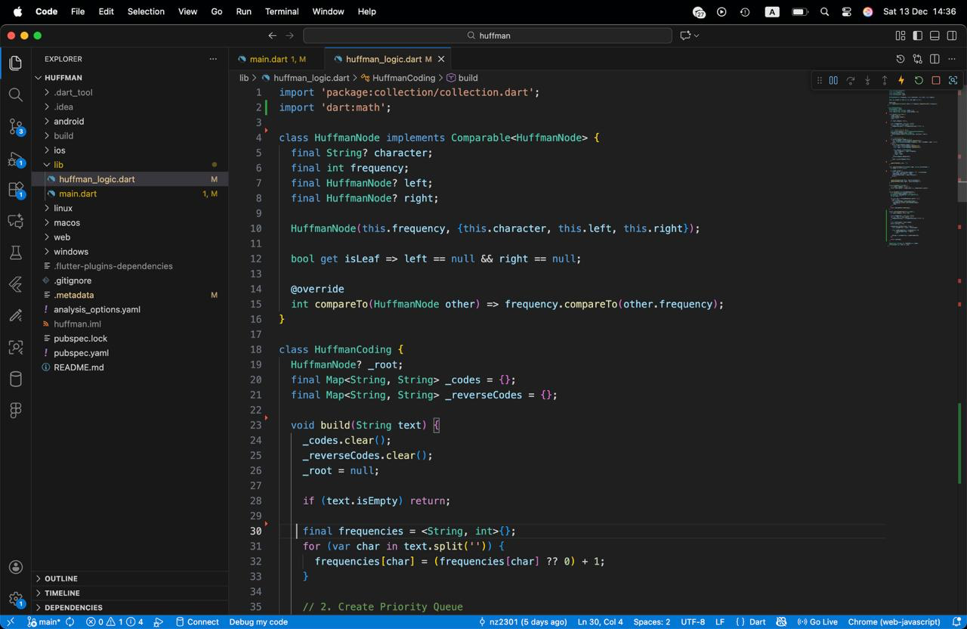
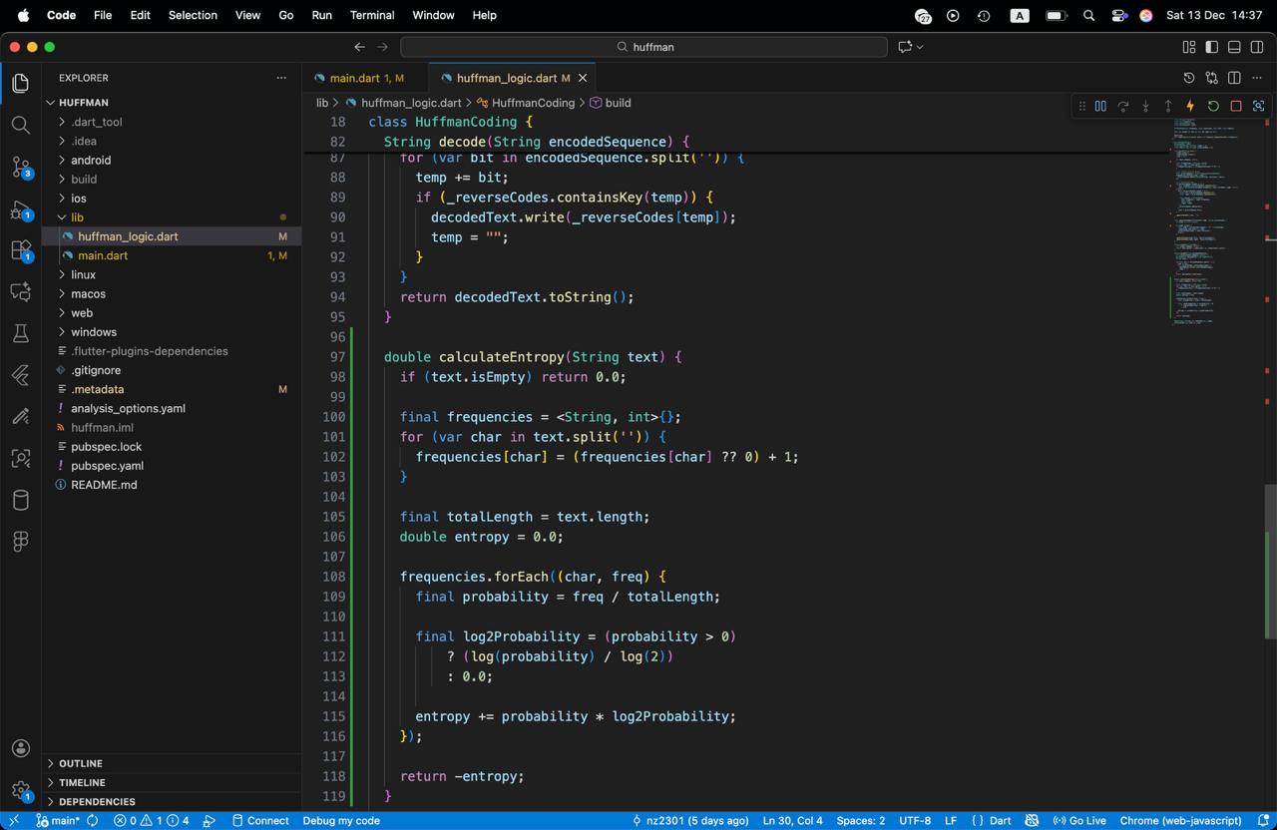
Implementation Details: Our Tech Stack
Language: Dart
Key Libraries
Chosen for its efficiency and robust ecosystem, forming the core of our application logic.
GraphView: Essential for rendering the intricate tree structures, employing the BuchheimWalkerAlgorithm for optimal layout.
Collection: Provided the foundational PriorityQueue implementation, critical for the Huffman algorithm's efficiency.
Framework: Flutter
dart:html: Facilitated seamless web-based file input/output operations, enabling users to interact with their own data.
Enabled cross-platform development, specifically targeting web deployment for accessibility and interactive visualisation.

Slide 5
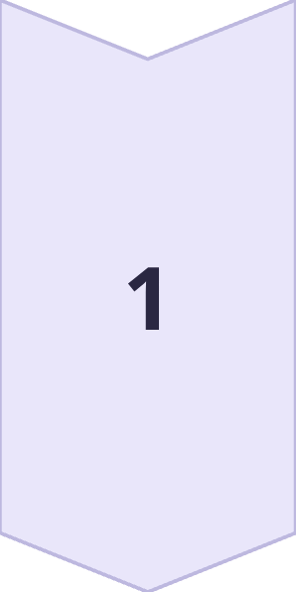
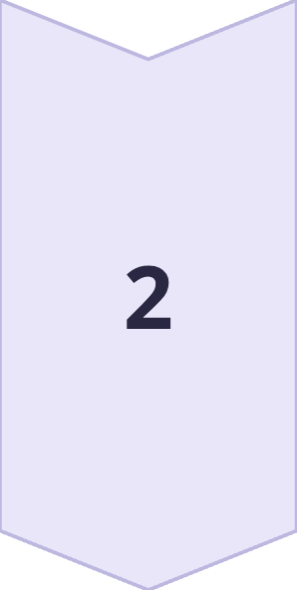
Project Architecture: Structured for Clarity
Our project adheres to a clean, modular architecture, separating concerns for maintainability and scalability.
Logic Layer
huffman_logic.dart contains the core algorithm:
HuffmanNode: Comparable by frequency for priority queue operations.
HuffmanCoding: Encapsulates build, encode, and decode functionalities.
UI Layer
main.dart manages the user interface:
Interactive TabBar: Allows switching between converter and visualizer modes.
State Management: Ensures real-time updates during encoding and decoding processes.

Slide 6
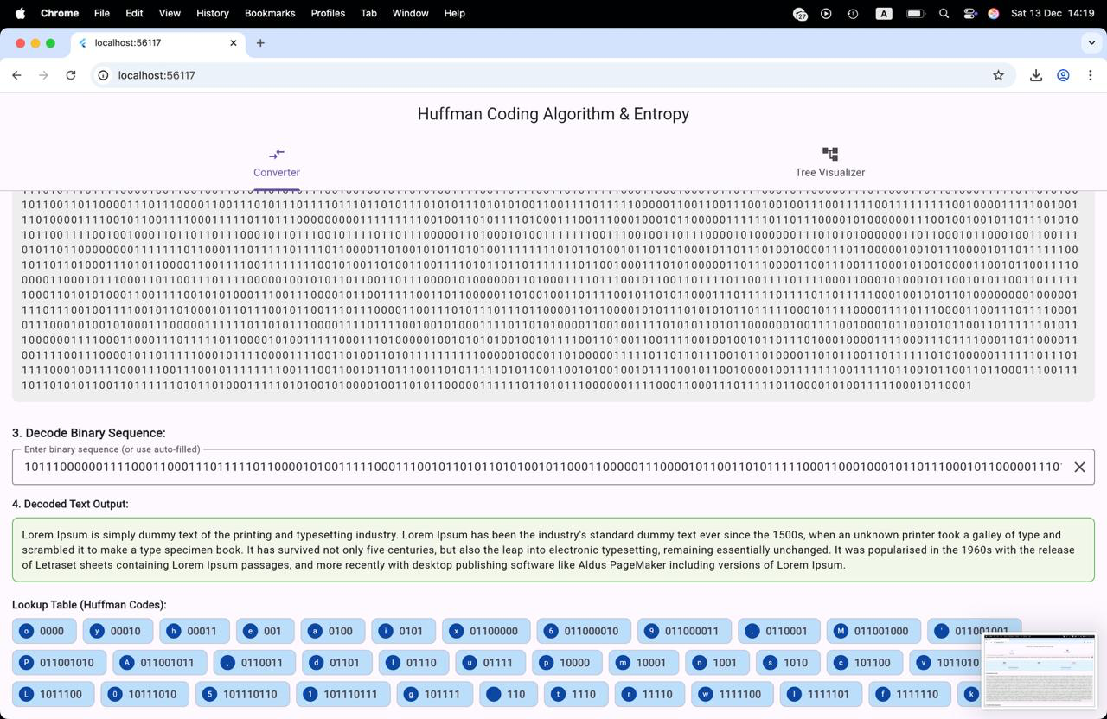

Key Features & Functionality
Our application is designed with a suite of features to provide a comprehensive and intuitive user experience.
Interactive Tree Visualisation
Users can explore the generated Huffman tree with interactive zooming and panning, powered by the BuchheimWalker algorithm.
Seamless File Operations
Supports uploading .txt files, processing byte arrays, and downloading the encoded binary output.

Slide 7
Challenges & Innovative Solutions
Challenge: Dynamic Tree Visualisation
Solution: GraphView Optimisation
Leveraged GraphView with precise sibling and level separation configurations to achieve an aesthetically pleasing and readable tree layout.
Visualising complex and dynamically generated tree structures posed a significant challenge for clarity and usability.
Challenge: Web File Handling
Solution: dart:html Integration
Managing file operations (upload/download) specifically within a Flutter web environment presented unique technical hurdles.
Implemented dart:html's FileReader for uploads and Blob for downloads, ensuring robust web-specific file I/O.

Slide 8






Conclusion: A Robust Educational Tool
Our project successfully delivers an efficient and educational Huffman encoding solution.
Educational Value
The application serves as an excellent pedagogical resource, simplifying the understanding of complex data compression principles through interactive visualisation.
Efficient Implementation
Achieved an O(n log n) algorithm for Huffman coding, aligning with best practices for data compression.
Practical Application
Demonstrates real-world application of algorithms and data structures, translating theoretical knowledge into a tangible product.

